Slide 1
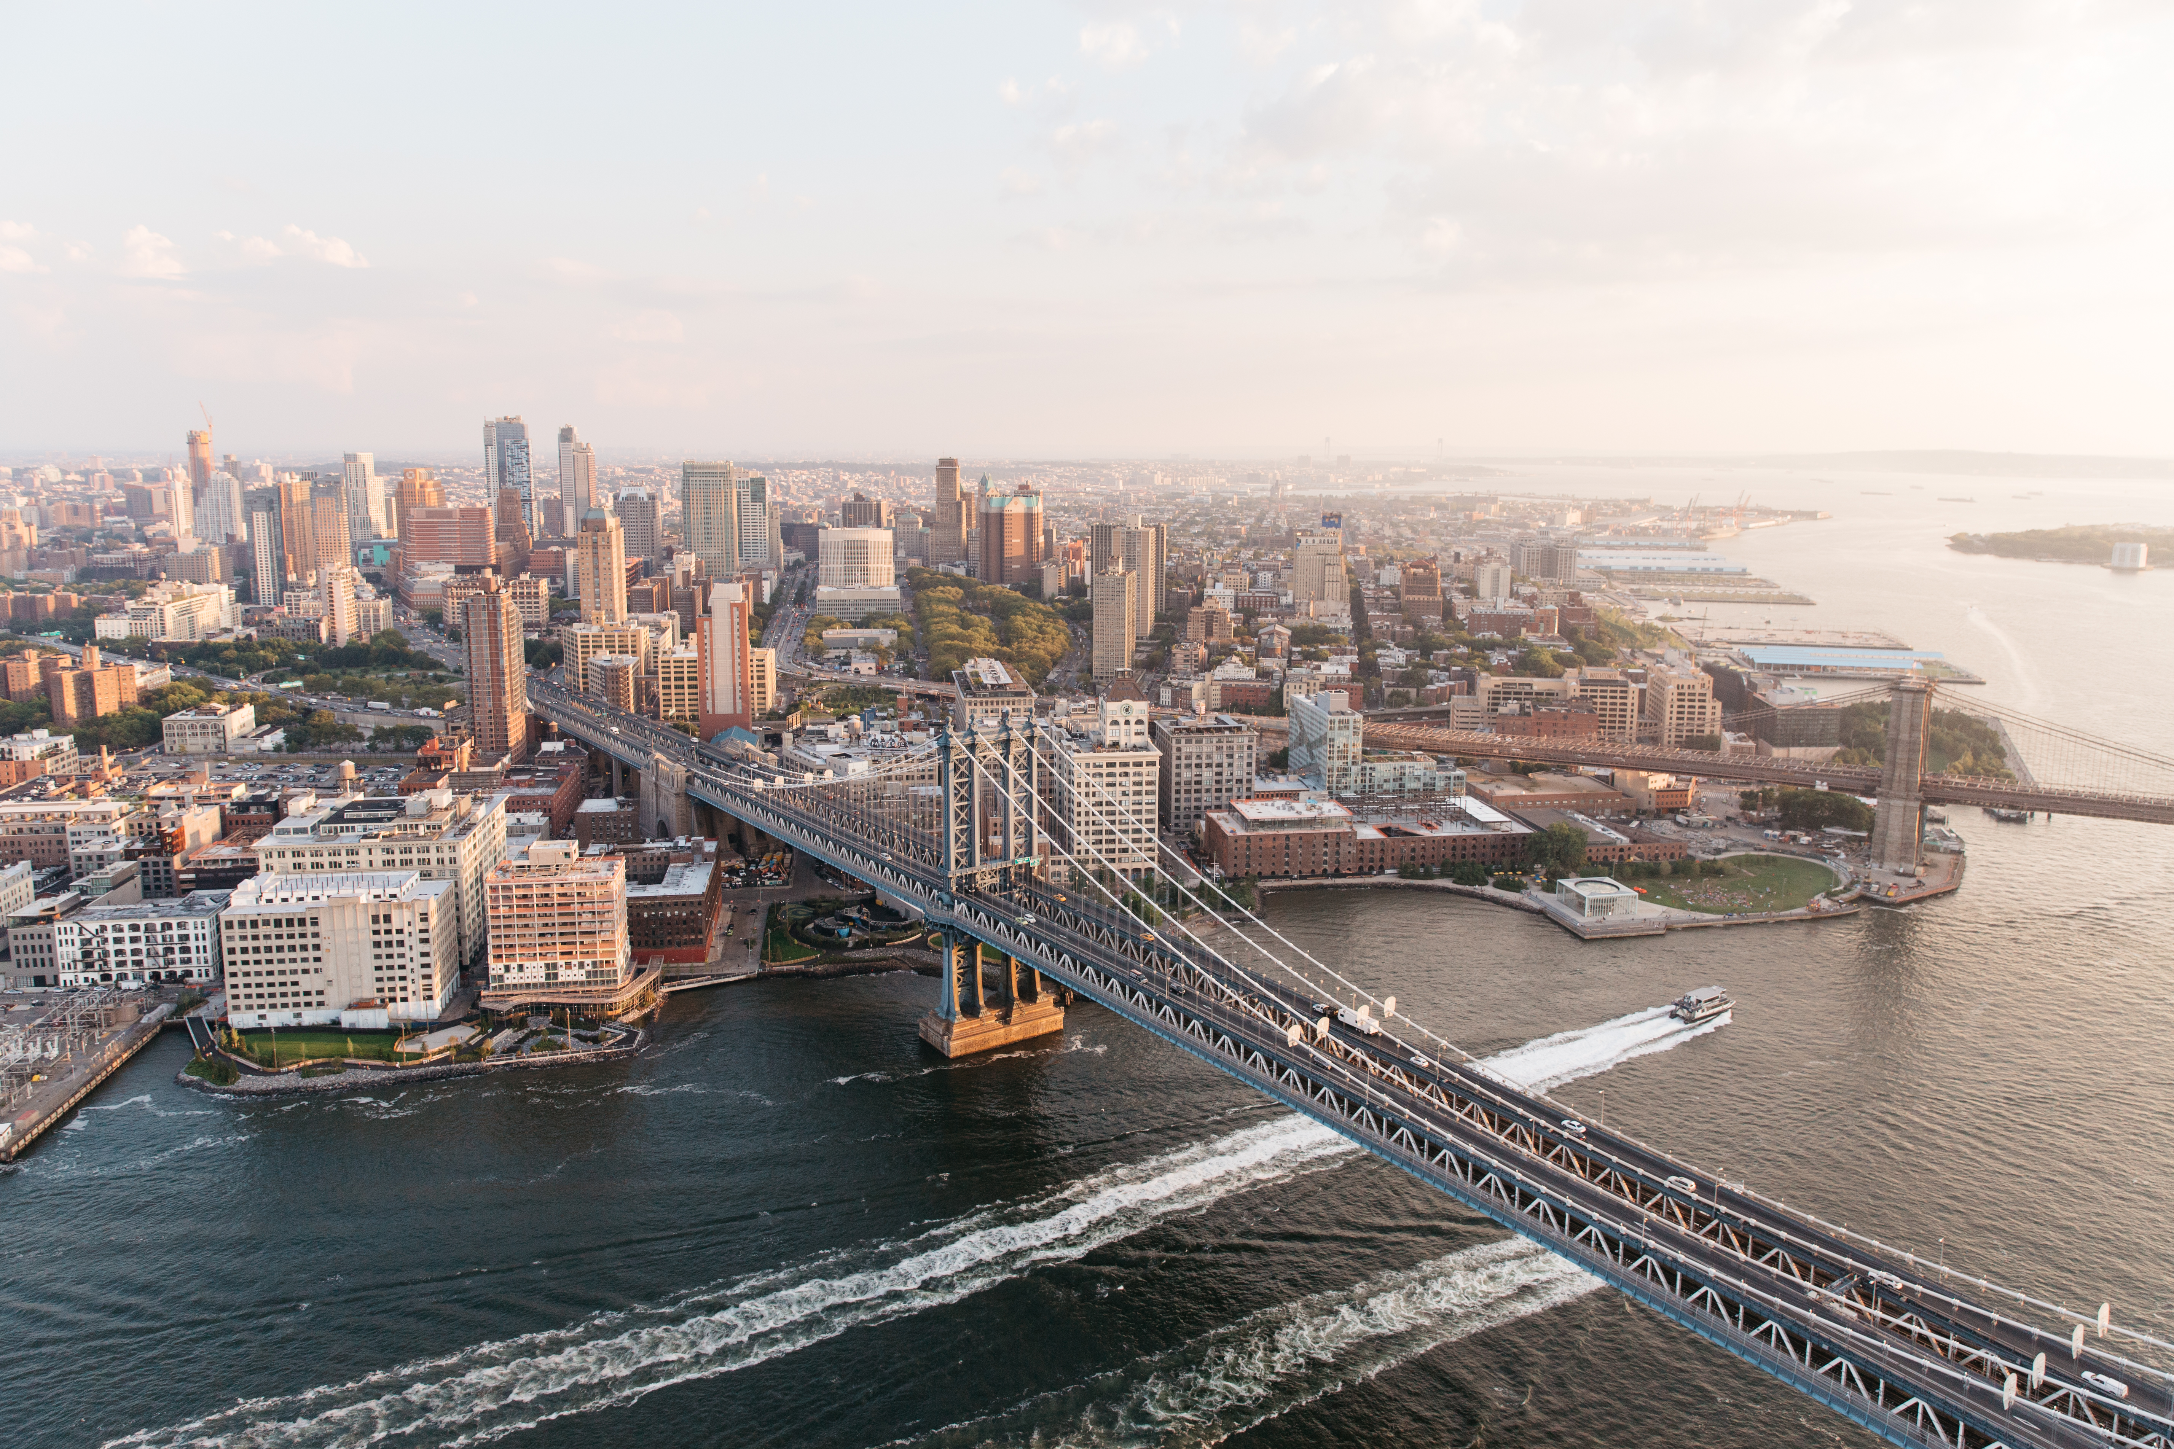
NICHE SOCIAL MEDIA MARKETING
STRATEGY AND IMPLEMENATION PLAN
{Jung Education}
{Yangha Park}
{12/8/2018}

Slide 2
contents
Organisation overview and research
Niche social media marketing strategy
Implementation plan

Slide 3
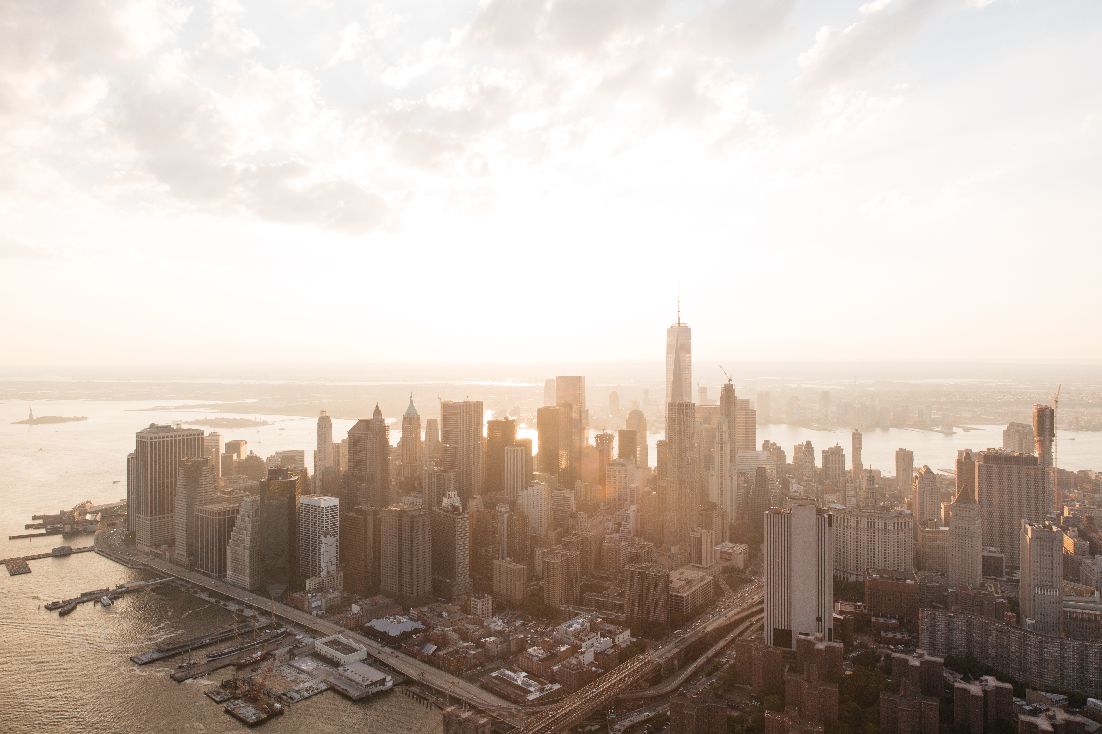
Stage 1.
Organisation OVERVIEW AND RESEARCH

Slide 4
ORGANISATION OVERVIEW
Provide an overview of the organisation you have selected for the purpose of this assessment and answer the key questions below in your description.
What is the name of the organisation? Jung Education
Please provide a brief history of the organisation. Established in 2006
What products and/or services does the organisation offer? Education
What is the pricing tier of the products and/or services offered? Various
What are the main sales channels? Naver Blog
Where is the organisation located? Sydney
What geographies does the organisation work in? Sydney
Who is the organisation’s target audience? 20-40 years old Korean living in Sydney with temporary visa and 18-40 years old Koreans who want to study in Australia.

Slide 5
NICHE SOCIAL MEDIA MARKETING STRATEGY AND CAMPAIGN AUDIT QUESTIONAIRE
Niche Social Media Marketing Interview Guide
Key stakeholder name |  | Interview date
Position |  | Interview time
Time with business |  | Interview place
Question |  | Answer

Slide 6
NICHE SOCIAL MEDIA NETWORK
Content CONSTRAINTs
Category | Constraint/Requirement
When not to post | When there is negative publicity about the organization and/or industry
What not to post | Racism, inappropriate language, something disrespectful to stakeholders, and/or competitors. Contents which implies piracy or plagiarization.
Where not to post | Competitors’ blogs or websites or social media channels or groups. Blogs, groups, social media channels where our audience is not there.
Who not to target | Elder people, People that don’t speak Korean, People that are not interested in moving to Australia.

Slide 7
NICHE SOCIAL MEDIA NETWORK
GLOBAL TRENDS
Case Study | Hoju Hyeong | StudyCo
Social Media Network | Facebook, Kakaotalk, Naver Blog | Facebook, Youtube, Instagram, google+, twitter, Whatsapp
Geography | Melbourne, VIC | Melbourne, VIC
Marketing Objective | Increasing the number of customers and brand awareness. | Increasing the number of customers and brand awareness.
Marketing Solution | Very active on social media. They created a lot of visual contents. They are highly communicative with customers. | They use many social media platform to contact customers.
Primary Benefit(s) | They helped 10,000 people in 5 years. | They helped 30,000 students in 20 years, and have 49 branches all around world.
Key global trends utilised in the strategy | Communicative attitude | Utilise social media channels

Slide 8
Stage 2.
NICHE SOCIAL MARKETING STRATEGY

Slide 9
NICHE SOCIAL MEDIA
STRATEGIC IDEAS
Primary Marketing Objective | Niche Social Media Marketing Options | Strategic Ideas | Second Marketing Benefits
Increase brand awareness and increase sales | Short videos (owned media) | How to video about purchasing goods for living in Australia How to video about choosing right education course for you Introducing good restaurants around Sydney | Establish the organisation’s expertise in the industry Increase website traffic Increase brand awareness Improve brand authority
 | Photographs (owned media) | Professional pictures of universities around Sydney Professional pictures | Establish the organisation’s expertise in the industry Increase website traffic Increase brand awareness Improve brand authority
 | Competition (promotional) | Selfie Contest | Increase engagement Increase customer referrals Develop a Kakaotalk database for future promotions
 | Industry news and tips (third party links) | Education industry news, Australia Immigration news, Update for immigration laws | Increase brand awareness Improve brand authority

Slide 10
NICHE SOCIAL MEDIA
STRATEGY SUMMARY
Category | Kakaotalk | Whatsapp | Vine | Vimeo | Tumblr | Medium | Reddit | Cross Promotional Networks / Activity
Owned media |  |  |  | ✓ How to guide | ✓ Competition |  |  | ✓ Facebook post
Promotional | ✓ Refer friends (voucher)
Third party media | ✓ Industry news
Paid Media
Community Management | ✓ Consultation | ✓ Consultation

Slide 11
NICHE SOCIAL MEDIA
CAMPAIGN SUMMARY
Strategy initiatives | Campaign /always on | Content idea | Niche social media network(s) | Cross Promotional network(s) / activity | Frequency | Key Performance Indicators (KPIs) | KPI targets (per month)
1 | Campaign | How to video about right education course | Vimeo | Facebook post Naver blog | Once | Website traffic Post likes Social media post shares | 10 post shares 1000 visitors
2 | Campaign | Industry news and updates about immigration laws | Kakaotalk | Facebook post Naver blog | N/A | Number of inquiry for consultation | 20 replies from customers
3 | Campaign | Selfie Contest | Tumblr | Facebook post Naver blog Instagram | Once | Post likes Post shares Comments | 30 likes 10 shares 30 comments

Slide 12
NICHE SOCIAL MEDIA
BUDGET OVERVIEW
Strategic Initiative | Expense category | Expense item | Forecast monthly budget | Reporting frequency | Budget approval
Overall | Management/ measurement | Community manager | $1,000 | Once per month | Marketing Director
Campaign 1 | Content creation | Video director Copywriter | $200 $100 | Each campaign | Marketing Director
Campaign 2 | Content creation | Copywriter Research analyst | $100 $200 | Once per quarter | Community Manager
Campaign 3 | Content creation | Graphic designer Copywriter | $200 $100 | Every weeks | Marketing Director
Totals___

Slide 13
Stage 3.
NICHE SOCIAL MARKETING IMPLEMENTATION PLAN

Slide 14
NICHE SOCIAL MEDIA
IMPLEMENTATION PLAN
Campaign | Actions required | Task owner | Start date | End date
#1 How to video | Get information of universities around Sydney Get idea for video Video Editing Approve copy and video. | Video Director Copywriter | 5/8/2018 | 19/8/2018
#2 Industry News | Making document style sample. Approve copy and photographs. | Copywriter Graphic Designer | 12/8/2018 | 26/8/2018
#3 Selfie Contest | Write brief for copywriter and photographer Organise awards for engaging of people | Graphic Designer Copywriter | 19/8/2018 | 2/9/2018

Slide 15
NICHE SOCIAL MEDIA
AUDIENCE FEEDBACK PROCEDURE
Type of comment | Enquiry | Positive comment | Neutral | Negative comment
 |  |  |  | Genuine feedback | Negative comments | Offensive/spam | Serious issue
Description | General questions about services | Positive comments about the agency | Neutral comments about the agency | Actual and valid feedback from a client or customer | A comment from an angry customer who is trying to battle the profile | Use of foul and malicious language, inappropriate ‘spam’ comment | Involves legal actions, threats, breach of confidentially, blackmail, etc.
Example | Can you quote for Certificate III cookery course in Le Cordon Blu? | Thank you for this post. I solved my problem seeing this! | Good day to die | I think some your opinions in your post can cause a quarrel | Your company charge higher cost than all others! | Lonely? Come here to make you warm->>> http://goo.gl/tinder333 | I hurt my eyes as seeing your profile picture! My lawyer will contact you soon.
Recommended response and action | Provide clear and concise answer | Express gratitude for the positive comment | Leave funny reply | Take a screenshot | Take a screenshot | Remove the comment | Take a screenshot
 | Try to make a customer to come to the office. | Share positive feedback on social media networks |  | Offer apologies | Offer apologies | Leave funny reply below (e.g I’m coming…<3) | Escalate to senior management
 |  |  |  | Provide assurance that their feedback will be taken into consideration | Ask them back which exact point is the one that they feel bad |  | Refer to the management/legal department

Slide 16
NICHE SOCIAL MEDIA MARKETING SCHEDULE
Sunday | Monday | Tuesday | Wednesday | Thursday | Friday | Saturday
 | 1 | 2 | 3 | 4 | 5 | 6
 | - |  |  |  | #How to Video Project Start
7 | 8 | 9 | 10 | 11 | 12 | 13
 | - |  |  | #How to Video Final check | #Industry News Project Start
14 | 15 | 16 | 17 | 18 | 19 | 20
 |  |  |  | #Industry News Project Start | #Selfie Contest Project Start
21 | 22 | 23 | 24 | 25 | 26 | 27
 |  |  |  | #Selfie Contest Project Start
28 | 29 | 30 | 31

Slide 17

NICHE SOCIAL MEDIA
CAMPAIGN 1 CONTENT
Detail the content for the first campaign of the mainstream social media marketing strategy including the headline, any imagery and associated links that will be included where applicable.
Social media network | Content Type | Post Content | Associated Imagery | Associated Link / Tags (if applicable)
Vimeo | Video | HOW Can I Choose the right education course?
Facebook | Post | 10 special tips for choosing the right education course for you
Naver Blog | Blog | 당신에게 맞는 교육 이수 과정 찾는 10가지 팁

Slide 18

NICHE SOCIAL MEDIA
CAMPAIGN 2 CONTENT
Detail the content for the second campaign of the mainstream social media marketing strategy including the headline, any imagery and associated links that will be included where applicable.
Social media network | Content Type | Post Content | Associated Imagery | Associated Link / Tags (if applicable)
Kakaotalk | News(Post) | #호주 유학, 이민 8월 개혁안 소식!
Facebook | Post | August Education, Immigration News
Naver Blog | Blog | 호쥬 유학, 이민 8월 개혁안 소식

Slide 19

NICHE SOCIAL MEDIA
CAMPAIGN 3 CONTENT
Detail the content for the third campaign of the mainstream social media marketing strategy including the headline, any imagery and associated links that will be included where applicable.
Social media network | Content Type | Post Content | Associated Imagery | Associated Link / Tags (if applicable)
Tumblr | Post | Why not “Selphie” today? #Selfie Contest
Facebook | Post | Why not “Selphie” today? #Selfie Contest
Naver Blog | Blog | 정유학원배 셀피 콘테스트!

Slide 20
SMMNSM503A
BE
THE
EXPERT

